Slide 1
Summative Activity
2nd grade A,B,C,D

Slide 2
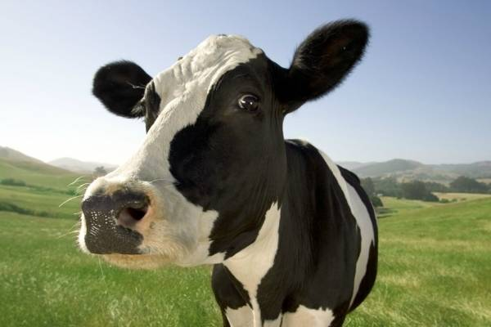
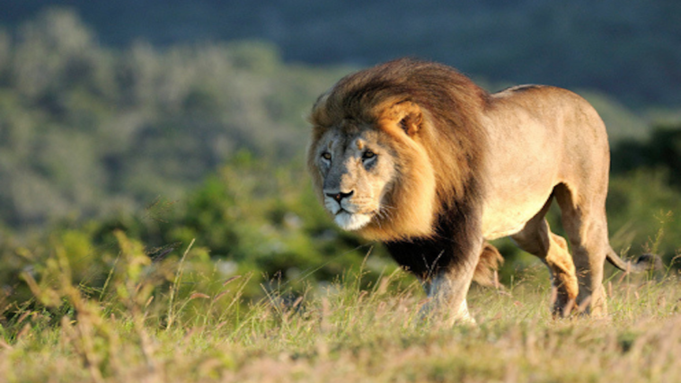
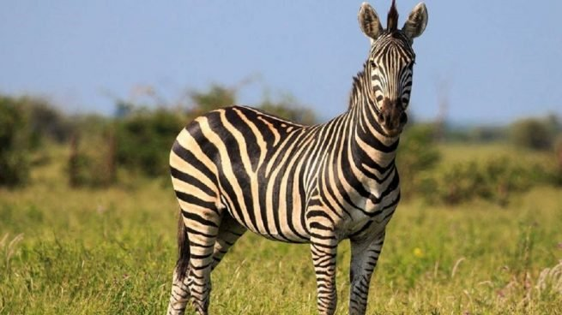
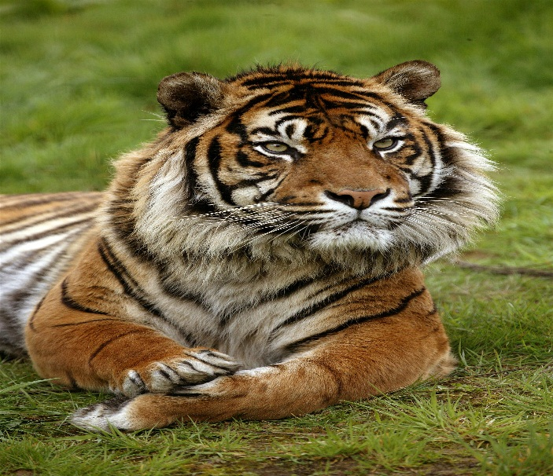
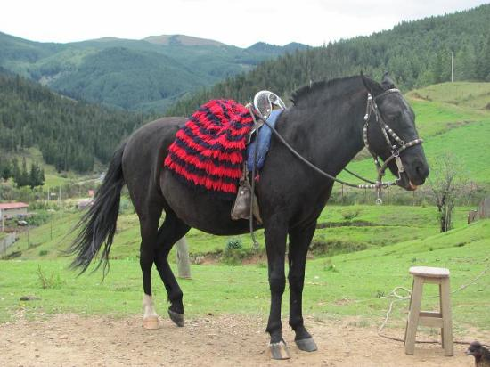
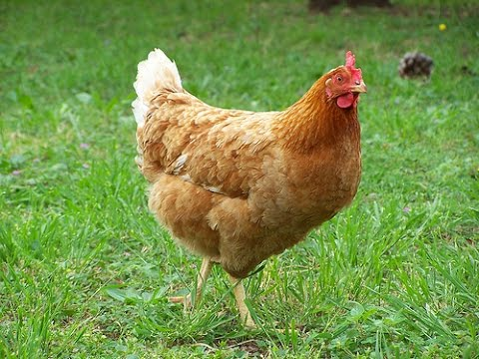
VOCABULARY
Exercise #1

Slide 3
EXERCISE #2
1.-Complete the sentences using personal pronouns: I, You,
She, He, It, We, They. Completa las oraciones con pronombres personales
Example: My sister likes horses.
She likes horses.
a.-Jenny feeds the hens.
_____ feeds the hens.
b.-My Friends ride horses.
_______ ride horses.
c.-My sister and I, watch the lions at the zoo.
_____ watch the lions at the zoo.
d. The tiger eats meat.
______eats meat.

Slide 4
Exercise #3
Record a video or voice memo of yourself, following these directions.
Grábate en un video o nota de voz, siguiendo las siguientes pautas:
1- Choose an animal (zoo or farm)
2-Greetings: Say Hello!
3-Tell us your name: My name is___________________
4-Create a sentence using personal pronouns and verb to be
Example: The elephant is my favorite animal, it is big.

