Slide 1
Summative Activity Unit 5
3rd grade A, B,C,D

Slide 2
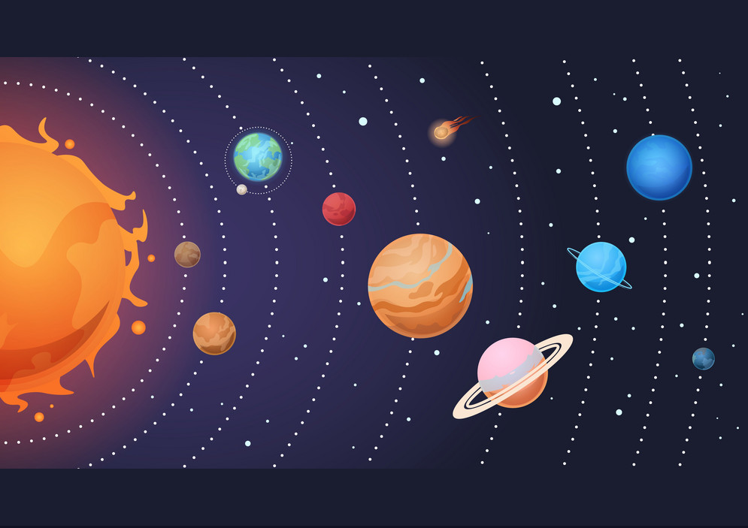
Exercise1: Listen to the 5 words mentioned and write them down in your notebook/
Escucha las 5 palabras mencionadas y escríbelas en tu cuaderno.

Slide 3
Exercise 2:
1. Earth. / planet / next to / is / Venus ___________________________________________
2. eight / the / There / planets / are / around / Sun. ___________________________________________
3. galaxy. / Milky Way / in / live / We / the ___________________________________________
4. Planet/ is/ third/ Earth/ the/ the Sun/ from
___________________________________________
Unscramble the following sentences/ Ordena las siguientes oraciones:

Slide 4
Exercise 3
Record a video or a voice memo of yourself/ Graba un video o audio.
I’d like you to mention the following/ Me encantaría que incluyeras:
1-Greetings: Hello, my name is______
2- My favorite planet in the Solar System is ______
3- I like it because ___________
(Ex. : It’s big, beautiful, red, it has rings around, it has moons, cold, hot)

