Slide 1
^{5th} grade
English class
Unit 6
YUMMY FOOD

Slide 2
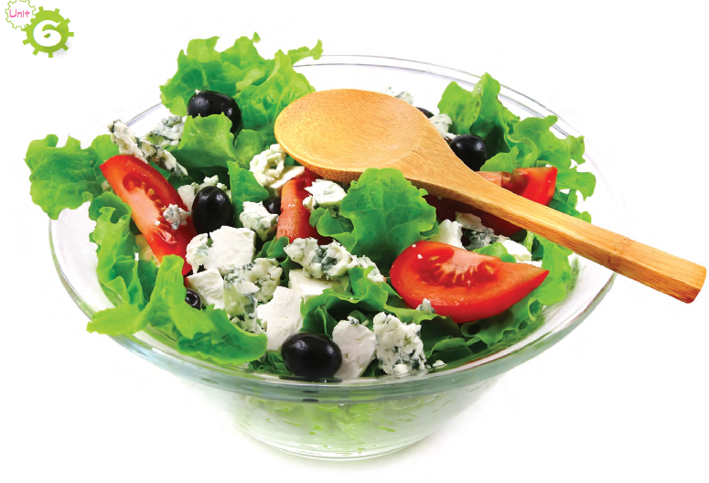
VOCABULARY: UNIT 6
Salad
Egg
Milk shake

Slide 3
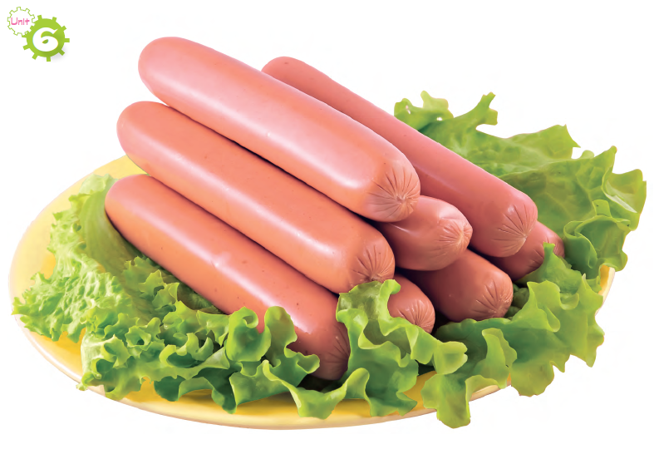
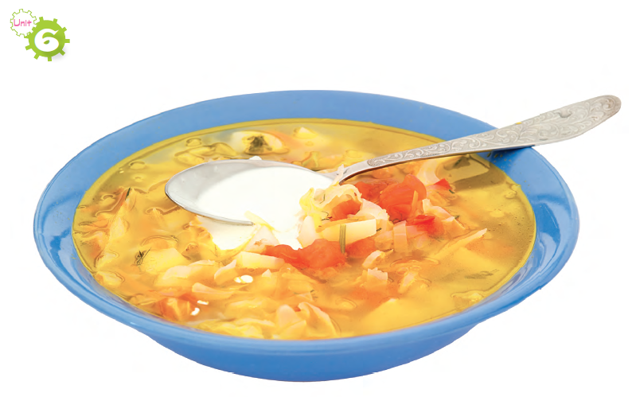
Strawberry
Pancakes
Soup
Sausages

Slide 4
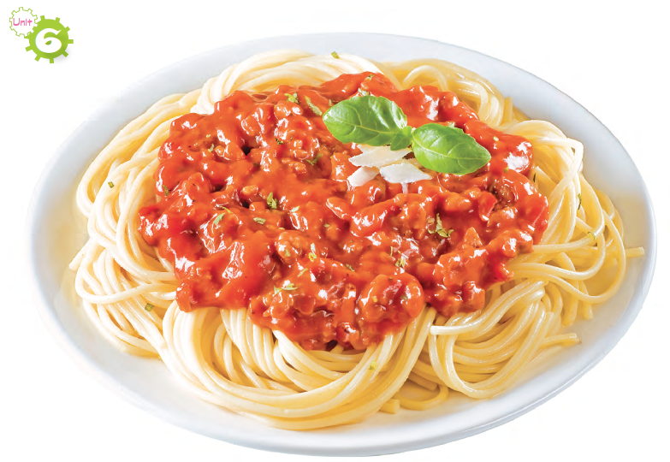
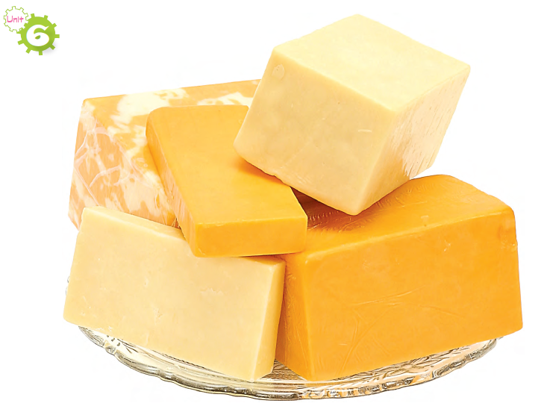
Cheese
Spaghetti
Chicken

Slide 5
VOCABULARY: UNIT 6
English | Español
Salad | Ensalada
Milkshake | Merengada
Egg | Huevo
Strawberry | Fresa
Pancakes | Panquecas
Sausages | Salchicha
Soup | Sopa
Cheese | Queso
Chicken | Pollo
Spaghetti | Espagueti

Slide 6
More VOCABULARY: UNIT 6
English | Español
Hamburger | Hamburguesa
Juice | Jugo
Sandwich | Emparedado
Tea | Té
Bacon | Tocineta
Honey | Miel
Oil | Aceite
Tomatoes | Tomate
yogurt | Yogur
fridge | Nevera
English | Español
Donut | Dona
cupcakes | Ponqués
oranges | Naranjas
Breakfast | Desayuno
Pudding | Pudin
Dinner | Cena
Lunch | Almuerzo
Roast beef | Carne asada
Meat | Carne
Meal | Comida

Slide 7
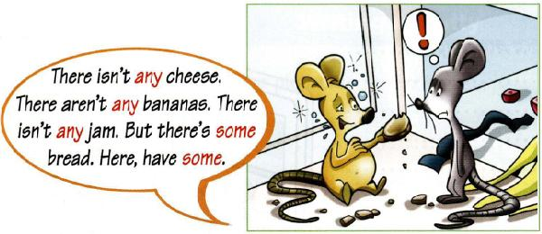
Grammar: UNIT 6
In this Unit we are going to learn to talk about COUNTABLE AND UNCOUNTABLE NOUNS. En esta unidad aprenderemos a hablar acerca de SUSTANTIVOS CONTABLES Y NO-CONTABLES.
- We use some with countable and uncountable nouns to express undefined quantity. Usamos some con sustantivos contables y no contables para expresar una cantidad indefinida
Ex: There is some cheese. Hay algo de queso
There are some apples. Hay algunas manzanas.
We use any with countable and uncountable nouns to express a lack of something.
Usamos any con sustantivos contables y no contables para expresar la carencia de alguna cosa.
Ex:There isn’t any soup. No hay nada de sopa
There aren’t any pancakes. No hay panquecas

Slide 8
Grammar: UNIT 6
Affirmative sentences
 | Verb BE (present) | SOME | Complement.
There | IS | SOME | CHEESE SALAD SPAGHETTI
 | Verb BE (present) | SOME | Complement.
There | ARE | SOME | MILK SHAKES EGGS STRAWBERRIES PANCAKES SAUSAGES SOUPS CHICKENS

Slide 9
Grammar: UNIT 6
Negative sentences
 | Verb BE (present) | ANY | Complement.
There | ISN´T | ANY | CHEESE SALAD SPAGHETTI
 | Verb BE (present) | ANY | Complement.
There | AREN´T | ANY | MILK SHAKES EGGS STRAWBERRIES PANCAKES SAUSAGES SOUPS CHICKENS

Slide 10
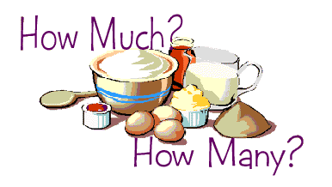
Grammar: UNIT 6
We use much / many to ask about the quantity of something. We use much for uncountable nouns and many for countable nouns. Usamos much / many para preguntar acerca de la cantidad de algo. Usamos much para sustantivos no contables y many para sustantivos contables.
How much bacon is there?
How many cupcakes are there?
Cuanta tocineta hay?
Cuantos ponques hay?

Slide 11
Question Word | Much/ many | Noun | Verb BE (in present) | THERE
HOW | MUCH | CHEESE SALAD SPAGHETTI | IS | THERE?
G
R
A
M
M
A
R
Question Word | Much/ many | Noun | Verb BE (in present) | THERE
HOW | MANY | MILK SHAKES EGGS STRAWBERRIES PANCAKES SAUSAGES SOUPS CHICKENS | ARE | THERE?

Slide 12
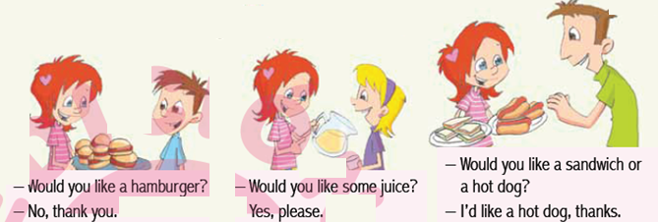
Question
Besides, we are going to learn about courtesy, how to make people feel welcome in your house Ademas, aprenderemos acerca de la cortesía, como hacer sentir a la gente que es bienvenida en tu casa
Modal verb | Subject. | verb | Complement.
WOULD | YOU | LIKE | CUPCAKES?

